Slide 1
Food Safety Management
System
HACCP (Hazard Analysis
Critical Control Point)
Varsha Misra,
Deputy Director
Quality Council of India
Varsha.qci.nabcb@gmail.com

Slide 2
Introduction to Food Safety
Food Safety means assurance that food is acceptable for human consumption according to its intended use.
Food Safety Management System means the adoption Good Manufacturing Practices, Good Hygienic Practices, Hazard Analysis and Critical Control Point and such other practices as may be specified by regulation, for the food business.

Slide 3
Introduction to Food Safety
Food Safety Hazard - biological, chemical or physical agent in food, or condition of food, with the potential to cause an adverse health effect.

Slide 4
Physical Hazards
Any foreign object (inanimate) found in the food or a naturally occurring object (bone in fillet), that poses; a hazard is called a ‘Physical Contamination’.
Common Physical Hazards include :
Glass Chipped, pieces of cutlery and crockery, Metal shavings from cans and foils stapler pins
Blades, Plastic films used for wrapping or chipped pieces of disposables, Lint and threads Band- aids Hair Finger nails Bones
Jewellery pieces

Slide 5
Chemical Hazards
Naturally occurring and Process Induced Chemical substances that can cause a food borne illness is called a ‘Chemical Contaminant or Hazard’.
Process Induced Chemical Contaminants include :
- Toxic metals in the catering set up or supply chain
Pesticides, Colorants
Cleansing products and sanitizers
Equipment lubricants
Chemical Food Additives, Preservatives
Packaging materials-migration of residues from packaging material to oil.
Adulteration with other oils or mineral oil

Slide 6
Natural Chemical Contaminants include :
- Allergens
- Mycotoxins

Slide 7
Biological Hazards
Biological hazards are organisms, or substances produced by organisms, that pose a threat to human health. They are a major concern in food processing because they cause most food borne illness outbreaks.
Major biological hazards include –
Bacteria ex: Salmonella spp., Enterohaemorrhagic Escherichia coli, Listeria monocytogenes, Staphylococcus aureus, Clostridium botulinum
- Yeast & Mold ex: Candida, Aspergillus sp, Helicosporium

Slide 8
Biological Hazards causes -
Food Borne Infections result when a person consumes food containing pathogens; which grow in the human intestine and cause discomfort or disease. Typical symptoms of a ‘food borne Infections’ do not appear immediately.
Food Borne Intoxications result when a person consumes food containing toxins in it; that cause discomfort or disease. Typical symptoms of a ‘food borne Intoxication’ appear quickly.
Food Borne toxin – mediated infections result when a person consumes food containing toxins produced by the pathogens in it; which grow in the human intestine and produce toxins that cause discomfort or disease.

Slide 9
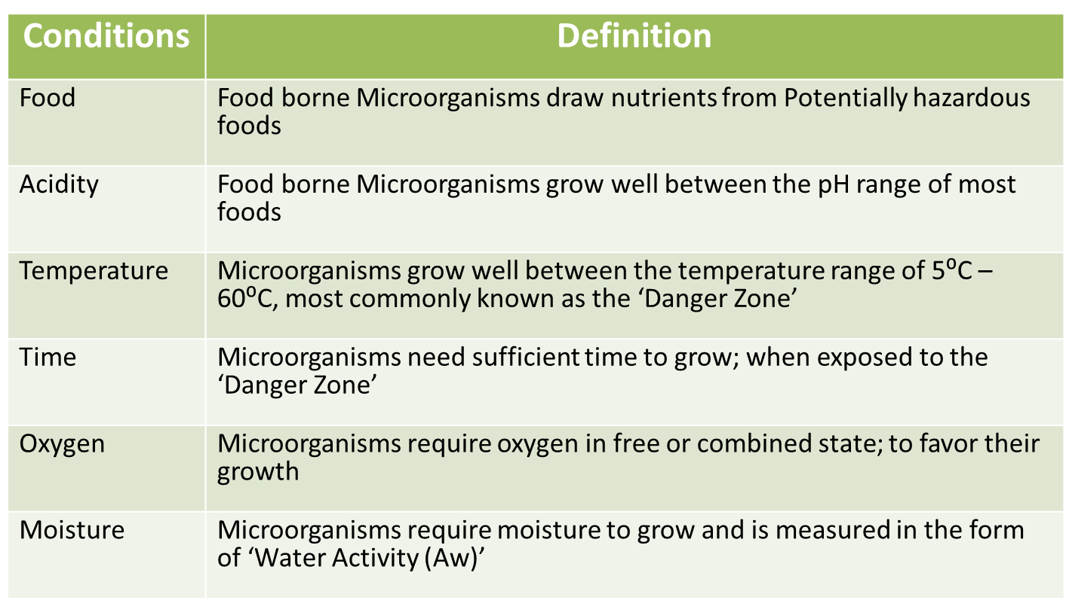
Conditions favouring growth of Microorganisms
FAT TOM

Slide 10

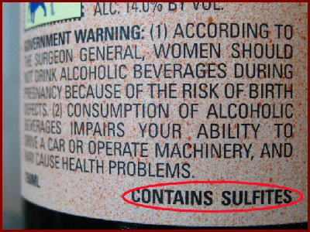

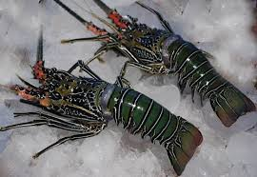

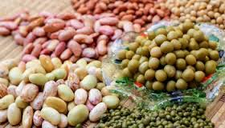


Allergens
Cereals containing gluten
Sulphite in concentrations
of 10 mg/kg or more
Tree nuts and nut products
Crustacea and products
of these
Fish and fish products
Peanuts, soybeans and
products of these
Eggs and egg products
Milk and milk products

Slide 11
Allergen Management
What is the responsibility of an oil company in Allergen Management?
What is the responsibility of the Food handler in Allergen Management?
What is the consumers responsibility in Allergen Management?
Allergies, Allergens
& Food Handlers

Slide 12

Foods Responsible for Allergic Reactions
Peanuts
Tree Nuts
Sesame Seeds
Eggs
Soybeans
Milk
Various grains and flours
Fish
Shellfish
Sulphites (10 ppm)

Slide 13
Responsibility of a FBO in Allergen Management?
Provide safe, wholesome food to the marketplace.
Provide proper information with the product to allow the consumer to make an informed choice.

Slide 14
Provide Safe, Wholesome Food to the Marketplace.
Allergen policy and program
Risk Assessment
Formulation Control
Ingredient Management
Process Controls
Packaging Management
Label Control
Employee Training

Slide 15
Allergen Program
  Production environment
  Responsibilities
  Consequences
  Be aware of employees with food allergies
  Have a response program in place
  Expectation of program
  Training
  Restriction of non approved ingredients
  Marketing program
  Hygienic practices
W5 &
How

Slide 16
Provide Safe, Wholesome Food to the Marketplace.
Policy, GMP, SOP, Monitoring, Deviation Procedure and Verification must state
  Who
  What
  When
  Where
  Why
  How
W5 &
How

Slide 17
Formulation Control
  No unapproved changes to formulation
  Use only most recent approved formula
  Follow SOP for scaling and use

Slide 18
Ingredient Management
  Purchase only from approved suppliers
  Purchase and use only approved ingredients
  Store to prevent damage and cross contamination

Slide 19
Process Control
Process Controls
  Sequencing Products
  Scaling (Scoop & Bins)
  Shielded lines
  Rework
  Label control
  Cleaning of equipment

Slide 20
Provide Proper Information with the Product Label
  Ingredient list
  Instructions for use
  Warnings
  Information
  Contact

Slide 21

Responsibilities of the Food Handler
Advise of formulation or process inefficiencies
Use only approved ingredients
Do not make decisions which can affect food integrity or safety unless empowered and trained to do so
Use product rework only in the product for which it was originally produced
Understand your responsibilities
Understand and do the job as trained

Slide 22
Responsibilities of the Food Handler
Prepare food which contain known allergens after all other products have been produced, follow sequence as directed.
Avoid cross-contamination
Wash hands thoroughly after handling known allergens
Wash hands thoroughly after eating

Slide 23
Responsibilities of the Food Handler
Keep aprons and clothing free of allergens
Follow a very thorough sanitation program to prevent cross-contamination.
Keep dust down
Keep all ingredients closed when not in use
Use only specified equipment and utensils

Slide 24
Consumers Responsibility
Report non conformities in labelling
Educate family and Consumers
Be aware of pitfalls
Make educated decisions based on reliable information

Slide 25

Remember
Don’t assume all people can use the food
Do your job as trained
Do not make decisions for the consumer
Do no cross contaminate
Properly label all food packet/containers
Be
Allergy Aware.
Be Concerned

Slide 26
GMP-GHP FOR ORGANIZED BIG RETAILERS
Location & surroundings
Layout & design of food premises / retail shops
Equipment & containers
Facilities
Operations & Controls
Management & Supervision
Food testing facilities
Audit, documentation & records
Sanitation & Maintenance of Establishment Premises
Personal Hygiene
Product Information & Consumer Awareness
Training

Slide 27
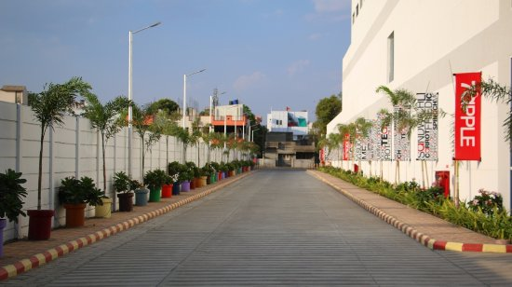
Location and Surroundings
Location shall be:
Away from environmentally polluted areas
Disagreeable or obnoxious odor,
Fumes
Excessive Soot
Smoke
Chemical or biological emissions
√ Should not have direct access to any residential area.

Slide 28
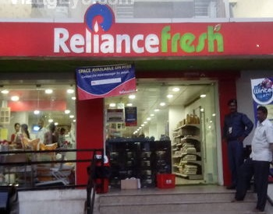
Layout & design of food establishment premises
▪ Enable separate & designated areas for storing of different varieties of products.
▪ Walls of the premises shall be tiled at operational height
▪ Floors, walls, ceilings, doors should be designed:-

Slide 29
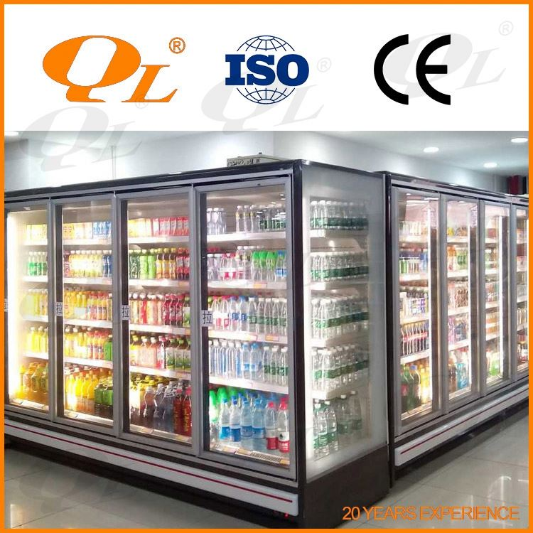
Equipment & Containers
  made up of non-corrosive / rust free material
  smooth, free from any grooves
  easy to clean and maintain
  non-toxic and non-reactive
  of food grade quality
  shall be stored at a designated place

Slide 30
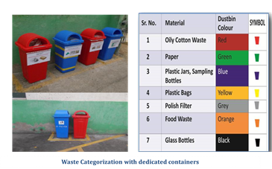
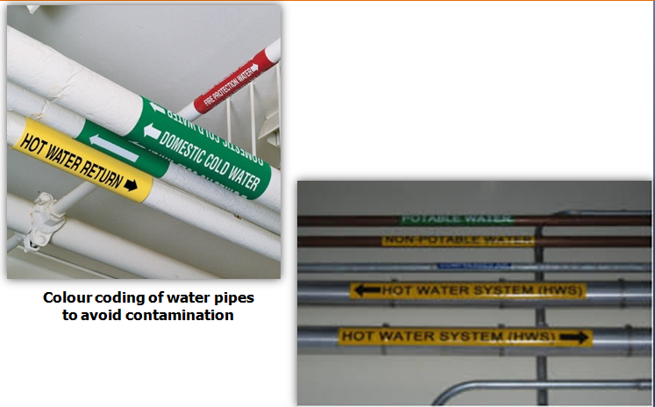
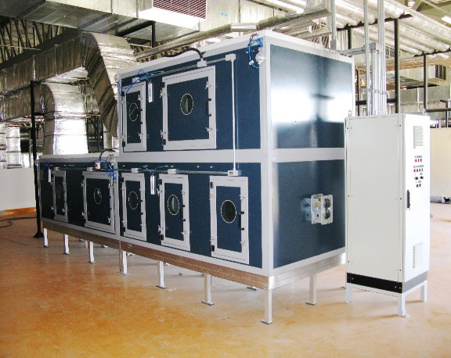
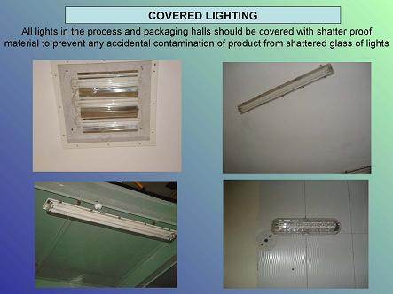
Facilities
Water Supply
Drainage & Waste disposal
Personnel facilities and toilets
Air quality and ventilation
Lighting

Slide 31

Water Supply:
Only potable water
Away from any hazards or contaminate
Periodic cleaning of storage tanks
Differentiated non- potable water pipes

Slide 32
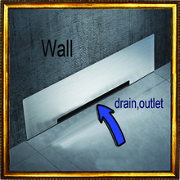

Drainage and waste disposal
Waste shall be regularly collected
Collected waste shall be stored so that it will not contaminate
Covered containers for waste storage
Waste shall be handed over to a local waste-collecting body
Periodic disposal of waste/refuse
Pedal operated adequate size bins

Slide 33

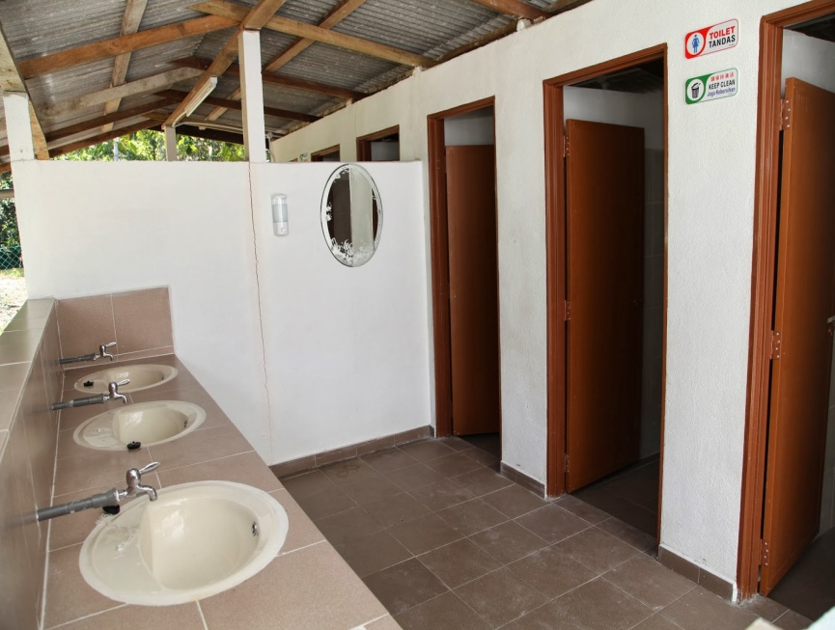
Personal facilities and toilets:
Facilities for washing and drying hands
Supply of hot and cold water
Separate lavatories for males and females
Suitably located Changing facilities for personnel
‘Do and Don’ts, Personal Hygiene, shall be put up

Slide 34
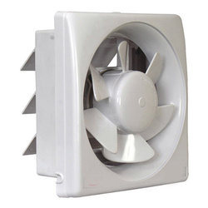
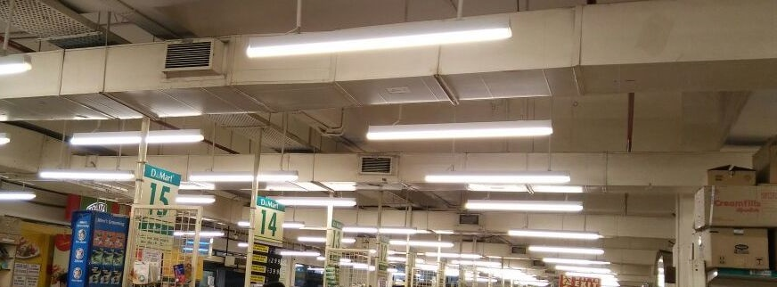
Ventilation & Lighting
Air quality and ventilation:
No contaminated air shall flow towards the clean area
Lighting :
Adequate Natural /artificial lighting
Protected lightings

Slide 35

Operations and Control:
Procurement of raw material:
Avoid extraneous matter, parasites and pesticides
Should be checked before acceptance
Food additives added or to be added shall conform to all regulations and standards

Slide 36
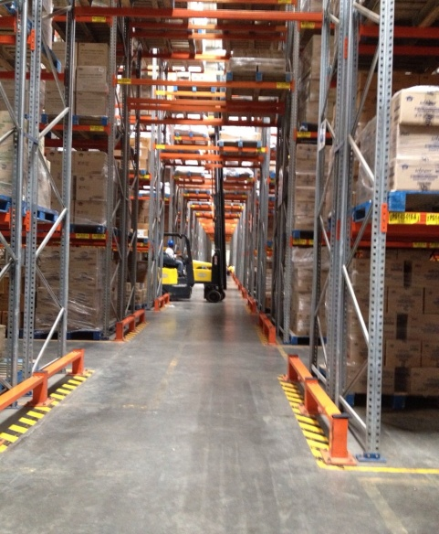
Operations and Control:
Storage of raw materials and food:
Storage practices shall be followed like:
Separation and segregation of material
Identification
FIFO system
Storage shall be off the floor and away from the wall

Slide 37
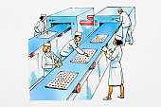
Operations and Control:
Food processing / preparation, packaging and distribution/ service:
- Food products under refrigerated / chilled conditions shall be monitored.
Time & temperature shall be noted
Care should be taken so that the defrosted / thawed material is not stored
back after opening

Slide 38
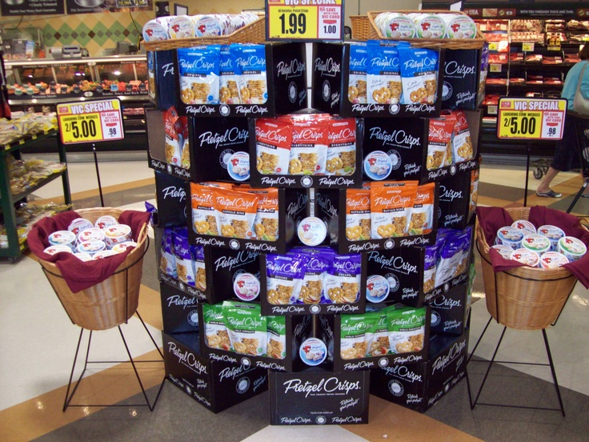
Operations and Control:
Food Packaging:-
Materials should be stored in clean containers.
Containers should be free from pest/rodent infestation
Material used for packing shall be made of food-grade material
Packaging material should conform to regulatory standards

Slide 39

Operations and Control:
Food distribution service:
Foods shall be protected from contamination
Hygienic and sanitary conditions shall be maintained
Cleaning & disinfection of vehicles shall be carried out between loads
Temperature controlled vehicles shall be used

Slide 40

Management and supervision:
Standard operating procedures for receiving of raw material, processing,
packaging, dispatch and storage
Operations shall be carried out and it shall be easily available
Technical persons shall be appointed

Slide 41
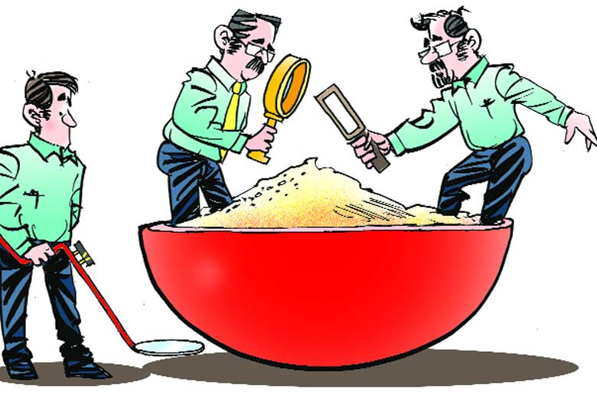
Food testing facilities:
Regular testing in accredited lab
For complaints retailer / FBO shall arrange for testing
from external laboratory

Slide 42

Audit, documentation and records:
Periodic review of GMP and GHP
Records of daily production / sales, raw material
Appropriate records shall be maintained
Example of common record maintained are:-
● raw material / product receiving
● processing
● laboratory test reports
● pest control reports
● cleaning and housekeeping reports
● personal hygiene
● waste disposal
● daily sales
● stock registers

Slide 43

Sanitation and maintenance of establishment premises
Cleaning and maintenance
Detailed cleaning and maintenance program
Cleaning chemicals and tools shall be stored away
Cleaning chemicals shall be clearly identified
Cleaning frequency, procedure, equipment, cleaning material and method should be
maintained

Slide 44

Sanitation and maintenance of establishment premises
Pest control systems
Non-attractive environment for the pests
A pest control program along with maintained date and frequency
For insects – insect-killer, fly-catcher, fly-killer,
For rodents – roda-box, rat trap
- Foods should be stored in pest-proof containers

Slide 45

Personal hygiene:
Health status:
Annually medical examination shall be carried out
Health check-ups and vaccination for food handlers
Record for all the check-ups as well for the vaccinations

Slide 46



Personal hygiene:
Personal cleanliness
Clean clothes / protective clothing,
Frequent hand washing
Trimming hair and nails should be practiced
Avoid smoking, spitting, sniffing,
do not eat or drink in processing area,
Avoid certain habits viz. scratching nose,
Running fingers through hair, scratching body parts, etc

Slide 47

Personal hygiene:
Visitors
Visitors should be discouraged
Proper care shall be taken to ensure food safety and hygiene
Shall follow all safety and hygiene

Slide 48
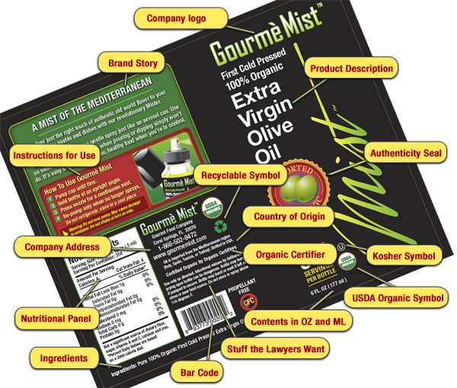
Product information and consumer awareness
All packaged food products shall be labelled as per labelling guideline
● Name of product
● Ingredients
● Nutritional information
● Veg / non-veg logo
● Name and address of
manufacturer
● Net quantity
● Lot / batch code
● Date of manufacture

Slide 49

Training
Effective and regular training for food handler
Personal behaviour, personal hygiene, and food safety during handling food,
storage, FIFO, etc.

Slide 50

FSMS Program
Defining the process steps
FSMS Plan
Receiving
Distribution
Storage
Storage and Holding
Preparation
Packaging and Labelling

Slide 51
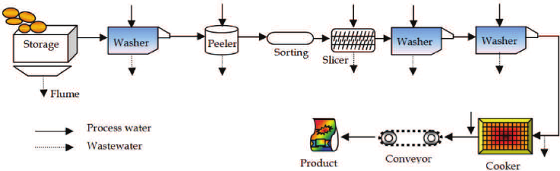
Process Flow Diagram Of Ready-to-eat Potato Chips

Slide 52
Hazard
A biological, chemical or physical agent in,
or condition of, food with the potential
to cause an adverse health effect.

Slide 53
Sources of Contamination-Physical/ Chemical/ Biological
People
Packaging materials
Machinery/Equipment
Premises
Pests
Environment
Raw materials
Pesticides, preservatives, mould inhibitors
Veterinary drugs
Cleaning chemicals
Food additives
Perfume, scented soap
Chemical reaction between metal and acidic food
Machine oils
Raw food
People
Equipment
Air and dust
Soil
Pests
Water
food waste

Slide 54
HACCP – Plan Introduction
HACCP stands for
Hazard
Analysis
Critical
Control
Point

Slide 55
History Of HACCP
Year 1959 Pillsbury developed HACCP system to meet requirements of “NASA” space program. Modes of failures concepts of US army Natick Lab. was the basis
Year 1969- Codex Alimentarius - Joint WHO/FAO body published guidelines for HACCP
Year 1985- Sub committee of National advisory Committee(NAS) developed report based on HACCP-1985
Year 1989- National Advisory Committee on Microbiological Criteria of Foods (NACMCF) established guidelines for HACCP
Year 1992- NACMCF redrafted the guidelines based on Codex

Slide 56
HACCP Definition
HACCP-Hazard Analysis and Critical Control Points
“Is a systematic approach to the identification and assessment of risk and severity, and control of biological, chemical and physical hazards associated with a particular food, production process or practice”

Slide 57
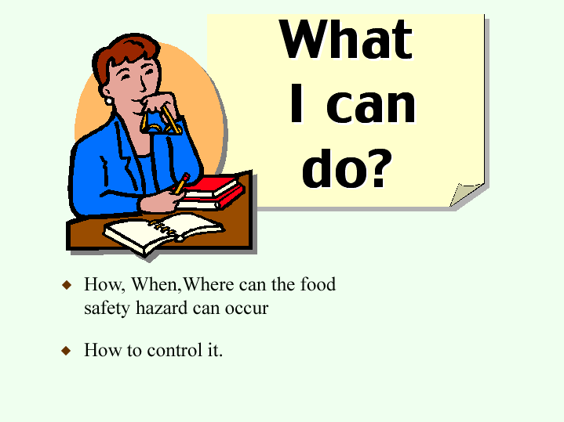
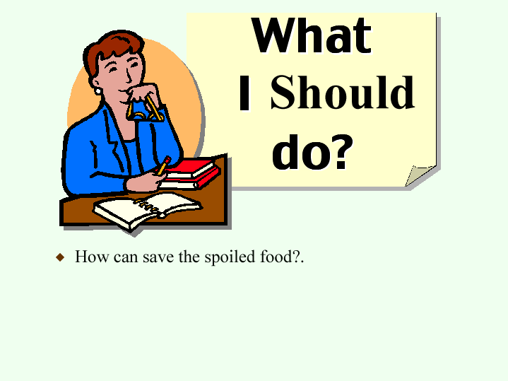
FSMS is
Rather than
Preventive and Pro active approach to control food safety hazards.

Slide 58
FSMS Principles
1. Conduct a hazard identification & risk assessment
2. Determine the CCPs
3. Establish critical limits
4. Establish a monitoring system
5. Establish corrective actions
6. Establish verification procedures
7. Establish documentation
58

Slide 59
Hazard Analysis
The process of collecting and interpreting
information on hazards and
conditions leading to their
presence to decide which are
significant for food safety

Slide 60
Risk Assessment
Probability / Likely hood
 | High (3) | Medium (2) | Low (1)
High (3) |  |  | GMP
Medium (2) |  | GMP | GMP
Low (1) | GMP | GMP | GMP
Severity or Consequence

Slide 61
What is a CCP?
Any activity that can be used to prevent , eliminate or reduce to an acceptable level a food safety hazard.
Control Measure
A step where control can be applied and is essential to prevent, eliminate or reduce a food safety hazard to acceptable levels.

Slide 62
Determine the CCPs :
Is control at this step
required for safety?
Q1. Are Control Measures
in place for the hazard ?
Modify Step
Process or
Product
Yes
No
Yes
No
Q2. Does the Process Step
eliminate or reduce the Hazard
to an acceptable level ?
Not a CCP
Yes
No
CCP
Q3. Could Contamination with
the Hazard occur at ,or increase
to, unacceptable levels ?
No
Not a CCP
Stop
Critical
Control
Point (CCP)
Yes
Q4. Will a Subsequent Process
Step eliminate or reduce the
Hazard to an acceptable level ?
Yes
No
CCP
Not a CCP

Slide 63
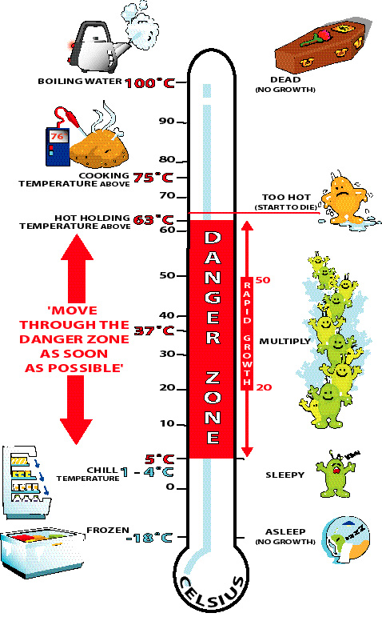
Establish Critical Limit(s) :
Establish target levels and tolerance which must be met to ensure each CCP is under control
Specify the criteria which MUST be met to ensure that each hazard (which makes a Process Step a CCP) is in “control”.
E.g. Heating Temperature and time
Double seaming effectiveness

Slide 64
Establish a Monitoring system
Establish a monitoring system to ensure control of the CCP by scheduled testing or observations.
Establish target levels and tolerance which must be met to ensure each CCP is under control.
Monitoring Procedures:
  What?
  When?
  Where?
  How?
  Who?

Slide 65
Establish Corrective Action
Establish corrective action, when a CCP is moving out of control.
  Adjust the process to bring back under control
  Action plan for non conforming material

Slide 66

Establish Verification Procedures :
Establish Verification Procedures, consisting of:
- Verification of Monitoring
- Verification of Corrective Action
Make practical plans for checking
whether the HACCP Plan is working
or not.
DUE
DILIGENCE

Slide 67
Establish Documentation
Establish documentation concerning all procedures and records

Slide 68

What is ISO?
International Standards for Business, Government and Society
www.iso.ch
The International Organization for Standardization (ISO) creates many different types of standards
  ISO is made up of standards institutes from 154 different countries
  Member countries work together to develop and approve standards

Slide 69
What is ISO 22000?
It is a Food Safety Management System (FSMS) that uses a management systems approach as well as a HACCP process.
The goal of ISO 22000 is to provide one internationally recognized standard for a food safety management system that can be applied to any organization in the food chain.

Slide 70

What is FS22000?
FS22000 is a Food Safety Certification Scheme that uses ISO 22000 and PAS 220
    PAS 220 specifies requirements for Prerequisite Programs for food manufacturers
    This document was added to ISO 22000 to create a system that could be benchmarked by the Global Food Safety Initiative

Slide 71
FS22000 or ISO 22000?
Manufacturers can choose ISO 22000 or FS22000
  If your customers want a GFSI registration scheme then you will use FS22000
  You will need to evaluate your market and determine which standard is most appropriate
FS22000 applies only to food manufacturer, so if you are not a manufacturer, you will use ISO 22000

Slide 72
Implementation Steps
An overview....
You will need to develop an implementation plan that covers:
  Education on the requirements of the standard
  A comparison of your current system to the requirements of ISO/FS22000 (Gap Analysis)
  A timeline of implementation tasks identified by the Gap Analysis
  Development of your HACCP plan
  Documentation of your system

Slide 73


WHAT IS CONFORMITY ASSESSMENT
NABCB Accreditation : Benefits and Uses
The process for demonstrating that specified requirements relating to a product, process, system, person or body are fulfilled Conformity assessment helps customer to select products and services

Slide 74




MAIN CONFORMITY ASSESSMENT ACTIVITIES
Testing
  Determination of one or more characteristics of an object of conformity assessment
Certification
  Third party assurance that: product (services), process, personnel, organization or management system conforms to specific requirements
Inspection
  Examination of a product design, product, process or installation and determination of its conformity with specific requirements or, on the basis of professional judgement, with general requirements
Validation & Verification
  Confirmation of claim, through the provision of objective evidence, that the requirements for a specific intended future use or application/past have been fulfilled

Slide 75



CONFORMITY ASSESSMENT
Testing – It involves laboratories which undertake
Testing of products like food, drugs, toys etc
Calibration of items to SI units
Medical Laboratories which test blood, urine etc
NABCB
www.nabcb.qci.org.in
75
75
75

Slide 76




TYPES OF CERTIFICATIONS
Process certification
Personnel certification
Systems certification
Product certification
Define competence in terms of knowledge and skills – evaluate – certify – Personnel (Yoga teachers, Welders, Crane operators)
Management systems standards like ISO 9001, ISO14001, ISO 45001,ISO 22000, ISO 27001, ISO 50001 - and the tribe is growing!!!
Organic, GlobalGAP
ISI Mark, Agmark

Slide 77
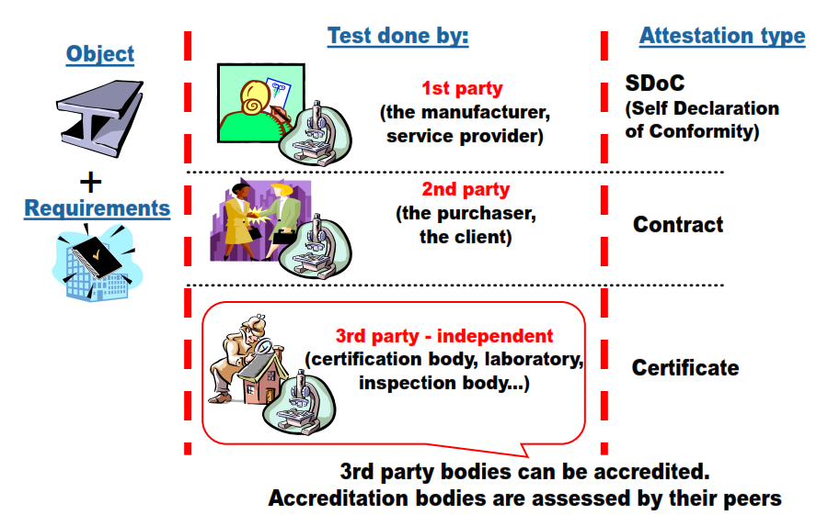
CONFORMITY ASSESSMENT CLAIMS

Slide 78


CONFORMITY ASSESSMENT IN ACTION
How do you determine if a product meets a technical requirement
Action | Conformity Assessment activity
Design the mobile device | Test design in laboratory
Mobile meets the technical specifications and standards | Test samples from production line
Manufacture the mobile | Quality management system (QMS) in place in the factory (certification of QMS)
Mobile sets in storage | Inspect samples of the sets prior to distribution to make sure no damage
Distribute to local shops | Take samples from the shop to ensure it meets specification (Market Surveillance) the regulator may do this

Slide 79

Accreditation
Third-party attestation related to a conformity assessment body conveying formal demonstration of its competence to carry out specific conformity assessment tasks – ISO/IEC 17000
Conformity Assessment Body is a body that performs conformity assessment activities and that can be the object of accreditation – ISO/IEC 17000
A global system for creating confidence between economies with the objective to promote economic growth and free trade
Conformity Assessment activities includes testing, calibration, inspection, certification of management systems, persons, products, processes and services, provision of proficiency testing, production of reference materials, validation and verification – ISO/IEC 17000

Slide 80

ACCREDITATION AND INTERNATIONAL EQUIVALENCE

Slide 81
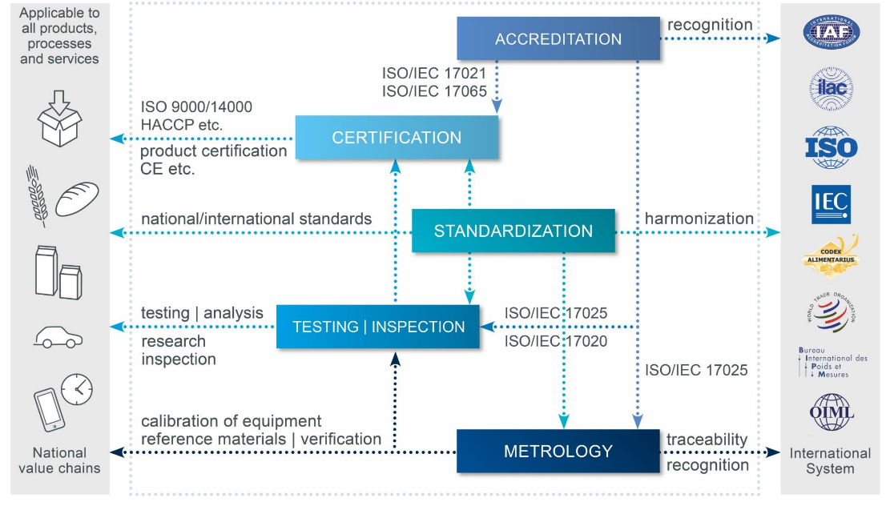
THE INTERNATIONAL ECOSYSTEM FOR QUALITY

Slide 82
Accreditation Standards
Standards | Conformity Assessment Bodies
ISO/IEC 17011 | Requirements for Accreditation Bodies
ISO/IEC 17020 | Requirements for Inspection Bodies
ISO/IEC 17021-1 | Requirements for Management Systems Certification Bodies – ISO 9001, 14001, 22000, 27006 …
ISO 22003 | Requirements for Certification Bodies for FSMS – basis for operation of CBs as well as their accreditation – cross refers to ISO 17021
ISO/IEC 17065 | Requirements for Certification Bodies Certifying Products, Processes and Services
ISO/IEC 17024 | Requirements for Certification Bodies Certifying Personnel
ISO 14065 | Requirements for Green House Gases Validation & Verification Bodies
ISO/IEC 17025 | Requirements for Testing & Calibration Laboratories
ISO/IEC 17043 | Requirements for Proficiency Testing Providers (PTPs)
ISO 17034 | Requirements for Reference Material Producers (RMPs)

Slide 83
International Framework
ACCREDITATION
Peer
Evaluation
International Standards
CONFORMITY ASSESSMENT BODIES
Standards / regulatory
requirements / scheme criteria
PRODUCT & SERVICE PROVIDERS
CONFIDENCE
TRUST
ASSURANCE
GOVERNMENT
CONSUMERS
PURCHASERS
NABCB and NABL together form part of international system of accreditation and equivalence operated under the aegis of the International Accreditation Forum (for Certification Bodies) and International Laboratory Accreditation Cooperation (for Inspection Bodies and Laboratories)

Slide 84






EQUIVALENCE FRAMEWORK
International
Multilateral Agreements
ILAC / IAF
Regional
Multilateral Agreements
EA
(Europe)
IAAC
(Americas)
APAC
(Asia Pacific)
AFRAC
(Africa)
National
Accreditation
Bodies
National
Accreditation
Bodies
National
Accreditation
Bodies
National
Accreditation
Bodies
NAB’s
NAB’s
NAB’s
NAB’s
NABCB
www.nabcb.qci.org.in
84

Slide 85







BENEFITS OF ACCREDITATION
Assurance of Technical Competence, Reliability and Integrity of Conformity Assessment Bodies
Customer Satisfaction, Minimizes Complaints
Increased Operational Efficiency, Effective Risk Management, Saves Time & Money
Facilitates Selection of Suppliers, Promotes Confidence in Imports, Avoids Re-testing/inspection
Demonstrates Compliance to Standards / Regulations / Requirements
Enhances Competitiveness, Marketing Advantage, Increased Business
International Equivalence/Acceptance/Recognition through Multilateral Mutual Recognition Arrangements and allow international acceptance of reports.
NABCB
www.nabcb.qci.org.in
85
85

Slide 86
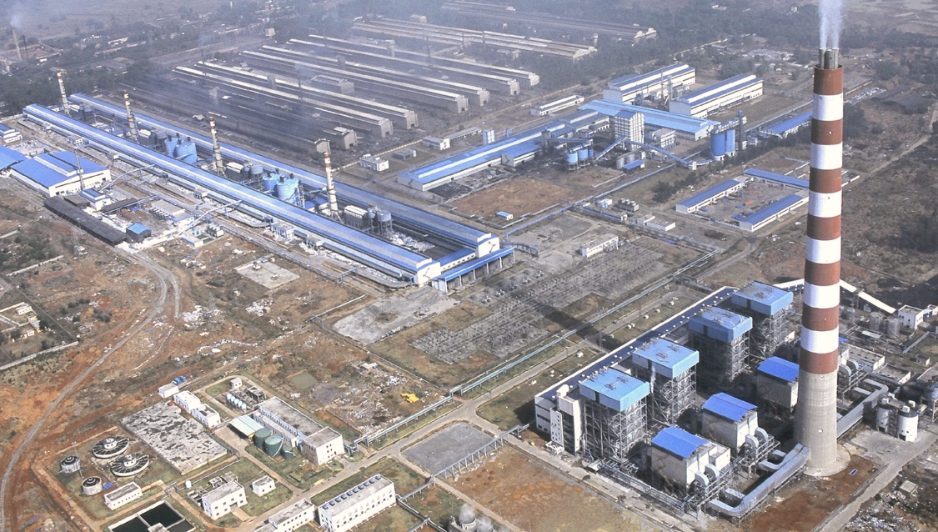
NABCB | NATIONAL ACCREDITATION BOARD FOR CERTIFICATION BODIES
SECTORS COVERED
Food products
Textiles and Textiles products
Leather and Leather products
Wood and Wood products
Pulp & Paper and paper products
Chemicals, Chemical products and fibres
Pharmaceuticals
Rubber & Plastic products
Concrete, Cement, Lime, Plaster etc.
Basic & Fabricated Metal products
Machinery & Equipment
Electrical and Optical Equipment
Ship building
Aerospace
Electricity supply
Gas supply
Water supply
Construction
Transport Storage & Communication
Public Administration
Education
…………and many more
NABCB
www.nabcb.qci.org.in
86
86

Slide 87













GOVERNMENT & REGULATORS RELY ON ACCREDITATION
Many Government Ministries, Regulators rely on Accreditation. Some of them are...
NABCB
www.nabcb.qci.org.in
87
87

Slide 88

ABOUT QUALITY COUNCIL OF INDIA
Quality Council of India
Creating an Ecosystem of Quality
NATIONAL
ACCREDITATION BODY
Established by Govt. of India and Indian Industry
Functionally autonomous | Financially independent
Department for Promotion of Industry and Internal Trade
is the nodal point in the
Ministry of Commerce and Industry
NABCB
www.nabcb.qci.org.in
88
88

Slide 89


THE INDIAN ECOSYSTEM FOR ACCREDITATION
About QCI
QCI Leadership
  Set up in Jan 1997 by the Government of India with ASSOCHAM, CII & FICCI
  QCI is an independent autonomous organization under the Department for Promotion of Industry and Internal Trade (DPIIT), Ministry of Commerce & Industry, Govt. of India.
  QCI was established as the National Accreditation Body and to lead a quality movement by undertaking a National Quality Campaign
  Chairman of QCI is appointed by the Hon’ble Prime Minister of India
Mr. Adil Zainulbhai
Chairman
Dr. R. P. Singh
Secretary General
QCI Mandate
  Provide Accreditation Framework in the country
  Spread quality movement in India
  Provide right and unbiased information on Quality & related Standards
  Represent India’s interest in International fora.
  Help establish quality of Indian products and services
NABCB
www.nabcb.qci.org.in
89
89

Slide 90






QCI : ORGANIZATION STRUCTURE
Council
Governing Body
Secretary General
Secretariat
accreditation
quality promotion
special projects group
NABCB
National Accreditation Board for Certification Bodies
NABL
National Accreditation Board for Testing and Calibration Laboratories
NABH
National Accreditation Board for Hospitals and Healthcare Providers
NABET
National Accreditation Board for Education and Training
NBQP
National Board
for
Quality Promotion
  PPID
  Project Planning and Implementation Division
  PADD
  Project Analysis and Documentation Division
  ZED
  Zero Defect and Zero Effect Division
NABCB
www.nabcb.qci.org.in
90
90

Slide 91
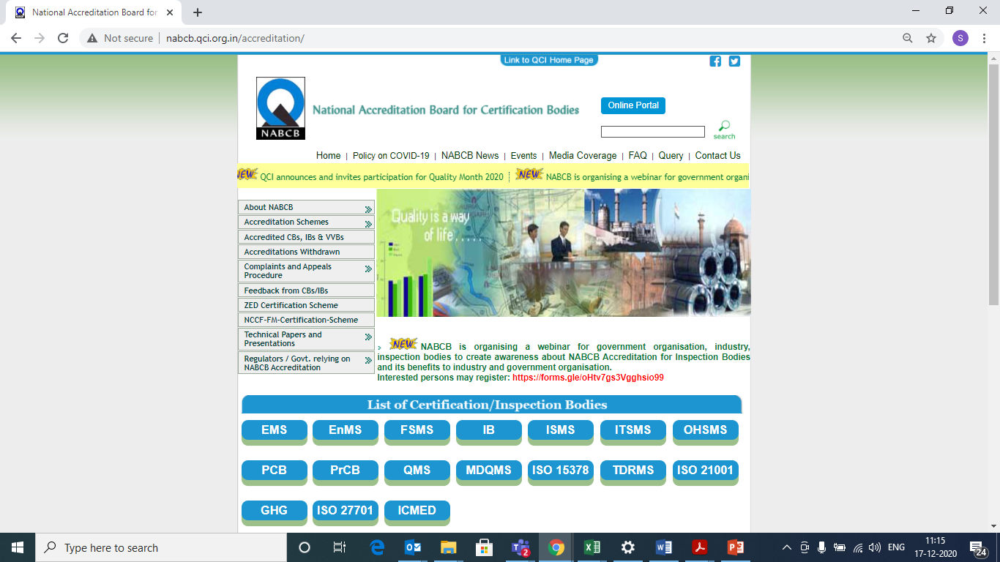
NABCB ACCREDITED CB & IB SEARCH
Website link for Accredited CABs
http://nabcb.qci.org.in/accreditation/
NABCB
www.nabcb.qci.org.in
91

Slide 92
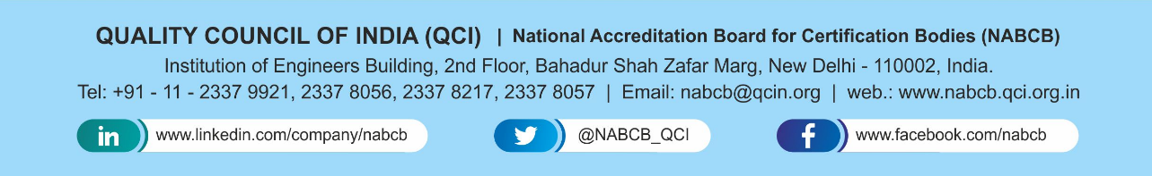

Thank You!!
National Accreditation Board for
Certification Bodies (NABCB)
Quality Council of India

