Slide 1


Government of India
Director ate General of Foreign Trade
Ministry of Commerce
EXPORT PROMOTION AND TRADE FACILITATION BY DGFT
Ramesh Kumar Verma,
Assistant DGFT

Slide 2
DGFT
DIRECTORATE GENERAL OF FOREIGN TRADE
Attached Office of Ministry of Commerce and Industry, Government of India
Major Functions:
  Formulation of Foreign Trade Policy
  Import / Export controls;
  Export Promotion;
  Issuance & monitoring of Certificates / Authorisation;
  Trade Facilitation and Grievance Redressal and CQCTD
  Enforcement .
Various Export Promotion Schemes
  Export Incentives e.g. MEIS, SEIS.
  Duty Free Import of inputs e.g. Advance Authorisation
  EPCG.

Slide 3
India’s Trade Performance
Merchandise exports increased from USD 275 billion in 2016-17 to USD 302 billion in 2017-18.
India’s overall exports (Merchandise and Services combined) in April-September 2018-19 are estimated to be USD 265.39 Billion, exhibiting a positive growth of 17.38 per cent over the same period last year.
MSMEs contribute about 45 percent of the manufacturing output, over 40 per cent of the total exports of the country, and around 8 percent of the country’s GDP.
For Engineering sector, September 2018 growth fell by 4.12% over the same month in 2017. September 2018, recorded an export value of USD 6996.69 million which is the second highest after April 2018 in the current fiscal.

Slide 4
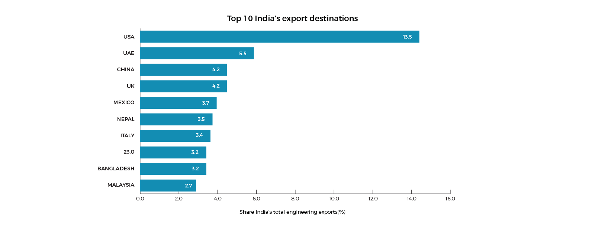
TOP EXPORT DESTINATION – ENGINEERING GOODS
USA ranked to be the top exporting destination for India's engineering products in September 2018

Slide 5
Foreign Trade Policy 2015-20
Formulated by the Ministry of Commerce and Industry; DGFT is the apex body implementing its provisions through a network of regional offices all over India
Objectives:
  USD 465.9 Billion to USD 900 Billion by 2020
  India’s share from 2% to 3.5%
Conventionally for 5 years from date of announcement
Mid term policy review in 05.12.2017.

Slide 6
What documents comprise the Foreign Trade Policy?
Foreign Trade Policy 2015-20
Highlights of the Foreign Trade Policy 2015-20
Foreign Trade Policy Statement
Handbook of Procedures 2015-20
ITC HS Schedule 1 and 2 for Import and Export
All these documents can be freely downloaded from www.dgft.gov.in

Slide 7
Foreign Trade Policy 2015-20 Highlights
BOOST TO "MAKE IN INDIA"
Reduced Export Obligation (EO) for domestic procurement under EPCG scheme: Specific Export Obligation under EPCG scheme, in case capital goods are procured from indigenous manufacturers, which is currently 90% of the normal export obligation (6 times at the duty saved amount) has been reduced to 75%, in order to promote domestic capital goods manufacturing industry.
Higher level of rewards under MEIS for export items with high domestic content and value addition.

Slide 8
Structure of Foreign Trade Policy
Chapter 3
Chapter 1 and 2
Promotional Measures
MEIS and SEIS
Duty Remission and Exemption Schemes
Export Promotion Capital Goods Scheme
Export Oriented Units/ EHTPs/ STPs/ BTPs
General Rules and Guidelines for Foreign Trade
Chapter 6
Chapter 4/ Chapter 7
Chapter 8
Complaints and Trade Disputes Redressal
Chapter 5

Slide 9
Export Promotion Schemes for Import / Procurement of Inputs
Export Promotion Schemes
Duty Exemption
Duty Neutralization / Remissions
Rewards / Incentives

Slide 10
Chapter 3 Schemes
Under Merchandise Exports from India Scheme (MEIS) and Services Exports from India Scheme (SEIS) duty credit Scrips are given.
Merchandise Exports from India Scheme (MEIS) under the FTP incentivizes exports of all notified products manufactured/ produced in India including those manufactured/produced by MSMEs by granting duty credit scrips at the rate of 2, 3, 4, 5, and 7% of the FOB value of exported goods.
Rate of incentives has been increased by 2% for labour intensive MSME sectors.
Status holder certificate (SHC) based on export performance of past 3 years: Double weightage to MSMEs
The Scrips can be used for Payment of
  Basic Customs Duties for import of inputs or goods, except items listed in Appendix 3A
  Use of these scrips for CGST/SGST/IGST will not continue. However, these scrips may be used for paying dues to DGFT such as composition/application fees etc
  These are transferrable scrips.

Slide 11
Chapter 4:
ADVANCE AUTHORISATION SCHEME and DFIA
Units primarily engaged in production for domestic market can get required inputs free of duty under Advance Authorization to service an export order.
Advance Authorization can be issued to a manufacture exporter or merchant exporter tied to a supporting manufacturer for physical exports;
AA can be issued for physical exports ( excluding supply to SEZs); supply of goods under deemed exports; for annual requirement; Intermediate supplies’; supply of stores on board the foreign going vessel/air craft subject to condition that there is specific SION in respect of items supplied.
Requirements:
Minimum prescribed value addition on imported inputs
Import will be allowed debiting the scrip for quantity and value
Execution of Bond/LUT
Non transferable

Slide 12
Chapter 5 – Export Promotion Capital Goods Scheme
Import of Capital goods for up gradation of technology and exports. Obligation fixed on duty saved to be fulfilled in 6 years.
To boost Make in India campaign, the specific export obligation for domestic procurement of capital goods has been reduced from 90% to 75% of the normal export obligation.
Period for maintenance of records after redemption of authorizations has been reduced from three years to two years.
The EPCG holder will have to pay IGST on import of Capital Goods and take Input Tax Credit.
ARO facility shall not be available for sourcing of Capital Goods manufactured indigenously

Slide 13
Validity and EO Periods
Scheme of FTP | Import Validity | Export Obligation Period
Advance Authorization | 12 months | 18 months
Appendix 4 J Items e.g. drugs | 12 months | 3 months to 12 months
Defence, Military Stores, Aerospace and Nuclear Energy | 12 months | Project period or 24 months whichever is more
DFIA | 12 months | Not Applicable
EPCG | 18 months | 6 years (4+2 block wise)
MEIS/SEIS | 18 months | -

Slide 14
FTP Schemes – Recent Changes
Currently, Duties at time of import exempted for export : Basic Customs Duty and Countervailing Duty (CVD) etc.
All existing authorizations/Scrips issued under FTP will be subject to provision as per new GST Provisions.
Expansion of Common service provider list in EPCG scheme to give boost to job working units.
Exemption of IGST and Compensation Cess under Advance Authorisation, EPCG and EOU schemes up to 31.03.2019
Changes in IEC notified through Trade Notice NO.23/2018 dated 08.08.2018
Online filing of SEIS and MEIS claims. No manual application. :Reduction in Transaction cost

Slide 15
Foreign Trade Policy 2015-20 Highlights
TRADE FACILITATION & EASE OF DOING BUSINESS
Online filing of documents/ applications and Paperless trade in 24x7 environment
Online inter-ministerial consultations
Simplification of procedures/processes, digitisation and e-governance
Several EDI initiatives
MSME clusters have been identified based on export potential of product and density of industry for focussed intervention to boost exports.
90 MSME clusters, which have been identified by DGFT are being targeted for imparting training/seminars regarding issues of international trade under Niryat Bandhu Scheme.

Slide 16
Foreign Trade Policy 2015-20 Highlights
FORTHCOMING E-GOVERNANCE INITIATIVES
Message exchange for transmission of export reward scrips from DGFT to Customs
Message exchange for transmission of Bills of Entry (import details) from Customs to DGFT.
Online issuance of Export Obligation Discharge Certificate (EODC)
Message exchange with Ministry of Corporate Affairs for CIN & DIN
Message exchange with CBDT for PAN
Facility to pay application fee using debit card / credit card
Open API for submission of IEC application.
A new Logistics Division has been created in the Department of Commerce to develop and coordinate integrated development of the logistics sector, by way of policy changes, improvement in existing procedures and introduction of technology based interventions in this sector.

Slide 17
Agri Exports from India
India, with a large and diverse agriculture, is among the world’s leading producer of cereals, milk, sugar, fruits and vegetables, spices, eggs and seafood products
Various studies on fresh fruits and vegetables, fisheries in India have indicated a loss percentage ranging from about 8% to 18% on account of poor post-harvest management, absence of cold chain and processing facilities.

Slide 18
Bake in India
It has often been suggested that an essential element of “Make in India” has to be “Bake in India”, i.e. a renewed focus on value addition and on processed agricultural products

Slide 19
India's Agriculture export Policy
Objectives
To double agricultural exports from present ~US$ 30+ Billion to ~US$ 60+ Billion by 2022 and reach US$ 100 Billion in the next few years thereafter, with a stable trade policy regime.
To diversify our export basket, destinations and boost high value and value added agricultural exports including focus on perishables.
To promote novel, indigenous, organic, ethnic, traditional and non-traditional Agri products exports.
To strive to double India’s share in world agri exports by integrating with global value chain at the earliest
Enable farmers to get benefit of export opportunities in overseas market.

Slide 20
State level export committee
The State level export monitoring committee chaired by the Chief Secretary and supported by the Regional Authorities of DGFT, autonomous bodies under Department of Commerce - Agricultural and Processed Food Products Export Development Authority (APEDA), Marine Products Exports Development Authority (MPEDA), Export Inspection Council (EIC), Spices Board, Coffee Board, Tea Board, Rubber Board, Tobacco Board, different Export Promotion Councils (EPC), Customs, Plant / animal Quarantine could provide the institutional mechanism for this purpose at the State level.

Slide 21
New Initiatives to be taken
India’s Best (Malaysia pattern )
Infrastructural issues .
SPS issues.

Slide 22
Thank You
Email: Rameshk.verma@nic.in
Contact Number: 9953204363

